Slide 1
Dynamic memory allocation

Slide 2
Outline
In this lesson, we will:
  Revisit static memory allocation (local variables)
  Introduce dynamic memory allocation
  Introduce the new and delete operators

Slide 3
Static memory allocation
Up to this point, all memory has been in the form of parameters or local variables
  The compiler arranges for memory to be allocated when the program executes
  Memory is allocated on call stack
  When a function exits, the only data that remains are either:
    values that are returned, or
    values that are thrown

Slide 4
Limitations of static memory
Suppose we need memory to exist outside the scope of a function
  Consider a text editor: the user could use it to type
    a 10-word response, or
    a 1000-line program
As the user types more and more characters, how do we keep allocating memory?
  All arrays are fixed in capacity, and yet the user can always keep typing no matter how large

Slide 5
Limitations of static memory
Is this a good program for a text editor?
    int main();
    int main() {
    char text[1000000]; // Allocate 1 MiB
    char[0] = '\0';
    // Do something with this character array...
    return 0;
    }

Slide 6
Limitations of static memory
By the way, an array is a horrible way of storing a text file:
  J.R.R. Tolkien just finishes his 500,000 character text “The Hobit”
  Fortunately, it fits into our 1 MiB file
    “The Lord of the Rings” does not…
  Suppose he finishes:
  "Chapter I\nAN UNEXPECTED PARTY\n\nIn a hole in the
  ground there lived a hobit. Not a nasty, dirty, wet
  hole, filled with the ends of worms and an oozy smell,
  nor yet a dry, bare, sandy hole with nothing in it to
  sit down on or to eat: it was a hobit-hole, and that
  means comfort."

Slide 7
Limitations of static memory
Tolkien decides that “Hōbit” just doesn’t sound right…
  He wants to change all “Hŏbbit” or just “Hobbit”
  Most characters will have to be moved between one and two hundred characters over to make space for all the missing “b”s
  Requiring that 500,000 characters to make small changes is probably a bad idea…
  "Chapter I\nAN UNEXPECTED PARTY\n\nIn a hole in the
  ground there lived a hobbit. Not a nasty, dirty, wet
  hole, filled with the ends of worms and an oozy smell,
  nor yet a dry, bare, sandy hole with nothing in it to
  sit down on or to eat: it was a hobbit-hole, and that
  means comfort."

Slide 8
Dynamic memory
We need some way of saying:
We need memory, but we need it to continue to be allocated outside of this function…
Question: Where can we get this memory?
  The memory required for a function call is just placed on top memory required for the previous function call
  What happens if you need 3 bits, 1 byte, 37 bits, 42 bytes, or
  2 400 000 bytes, which is enough for “The Lord of the Rings”?

Slide 9
Dynamic memory
Memory management is an issue dealt with by the operating system
  When you execute a program, it is the operating system that allocates the memory for the call stack
  If you want more memory, you must make a request to the operating system
Question: How do we allow this transaction?

Slide 10
Dynamic memory
First, the operating system can only deal in multiples of bytes
  If you want 3 bits, you must ask for a byte
  If you want 37 bits, you must ask for 5 bytes
Fortunately, all primitive data types occupy a multiple of bytes
  Even bool occupies one byte

Slide 11
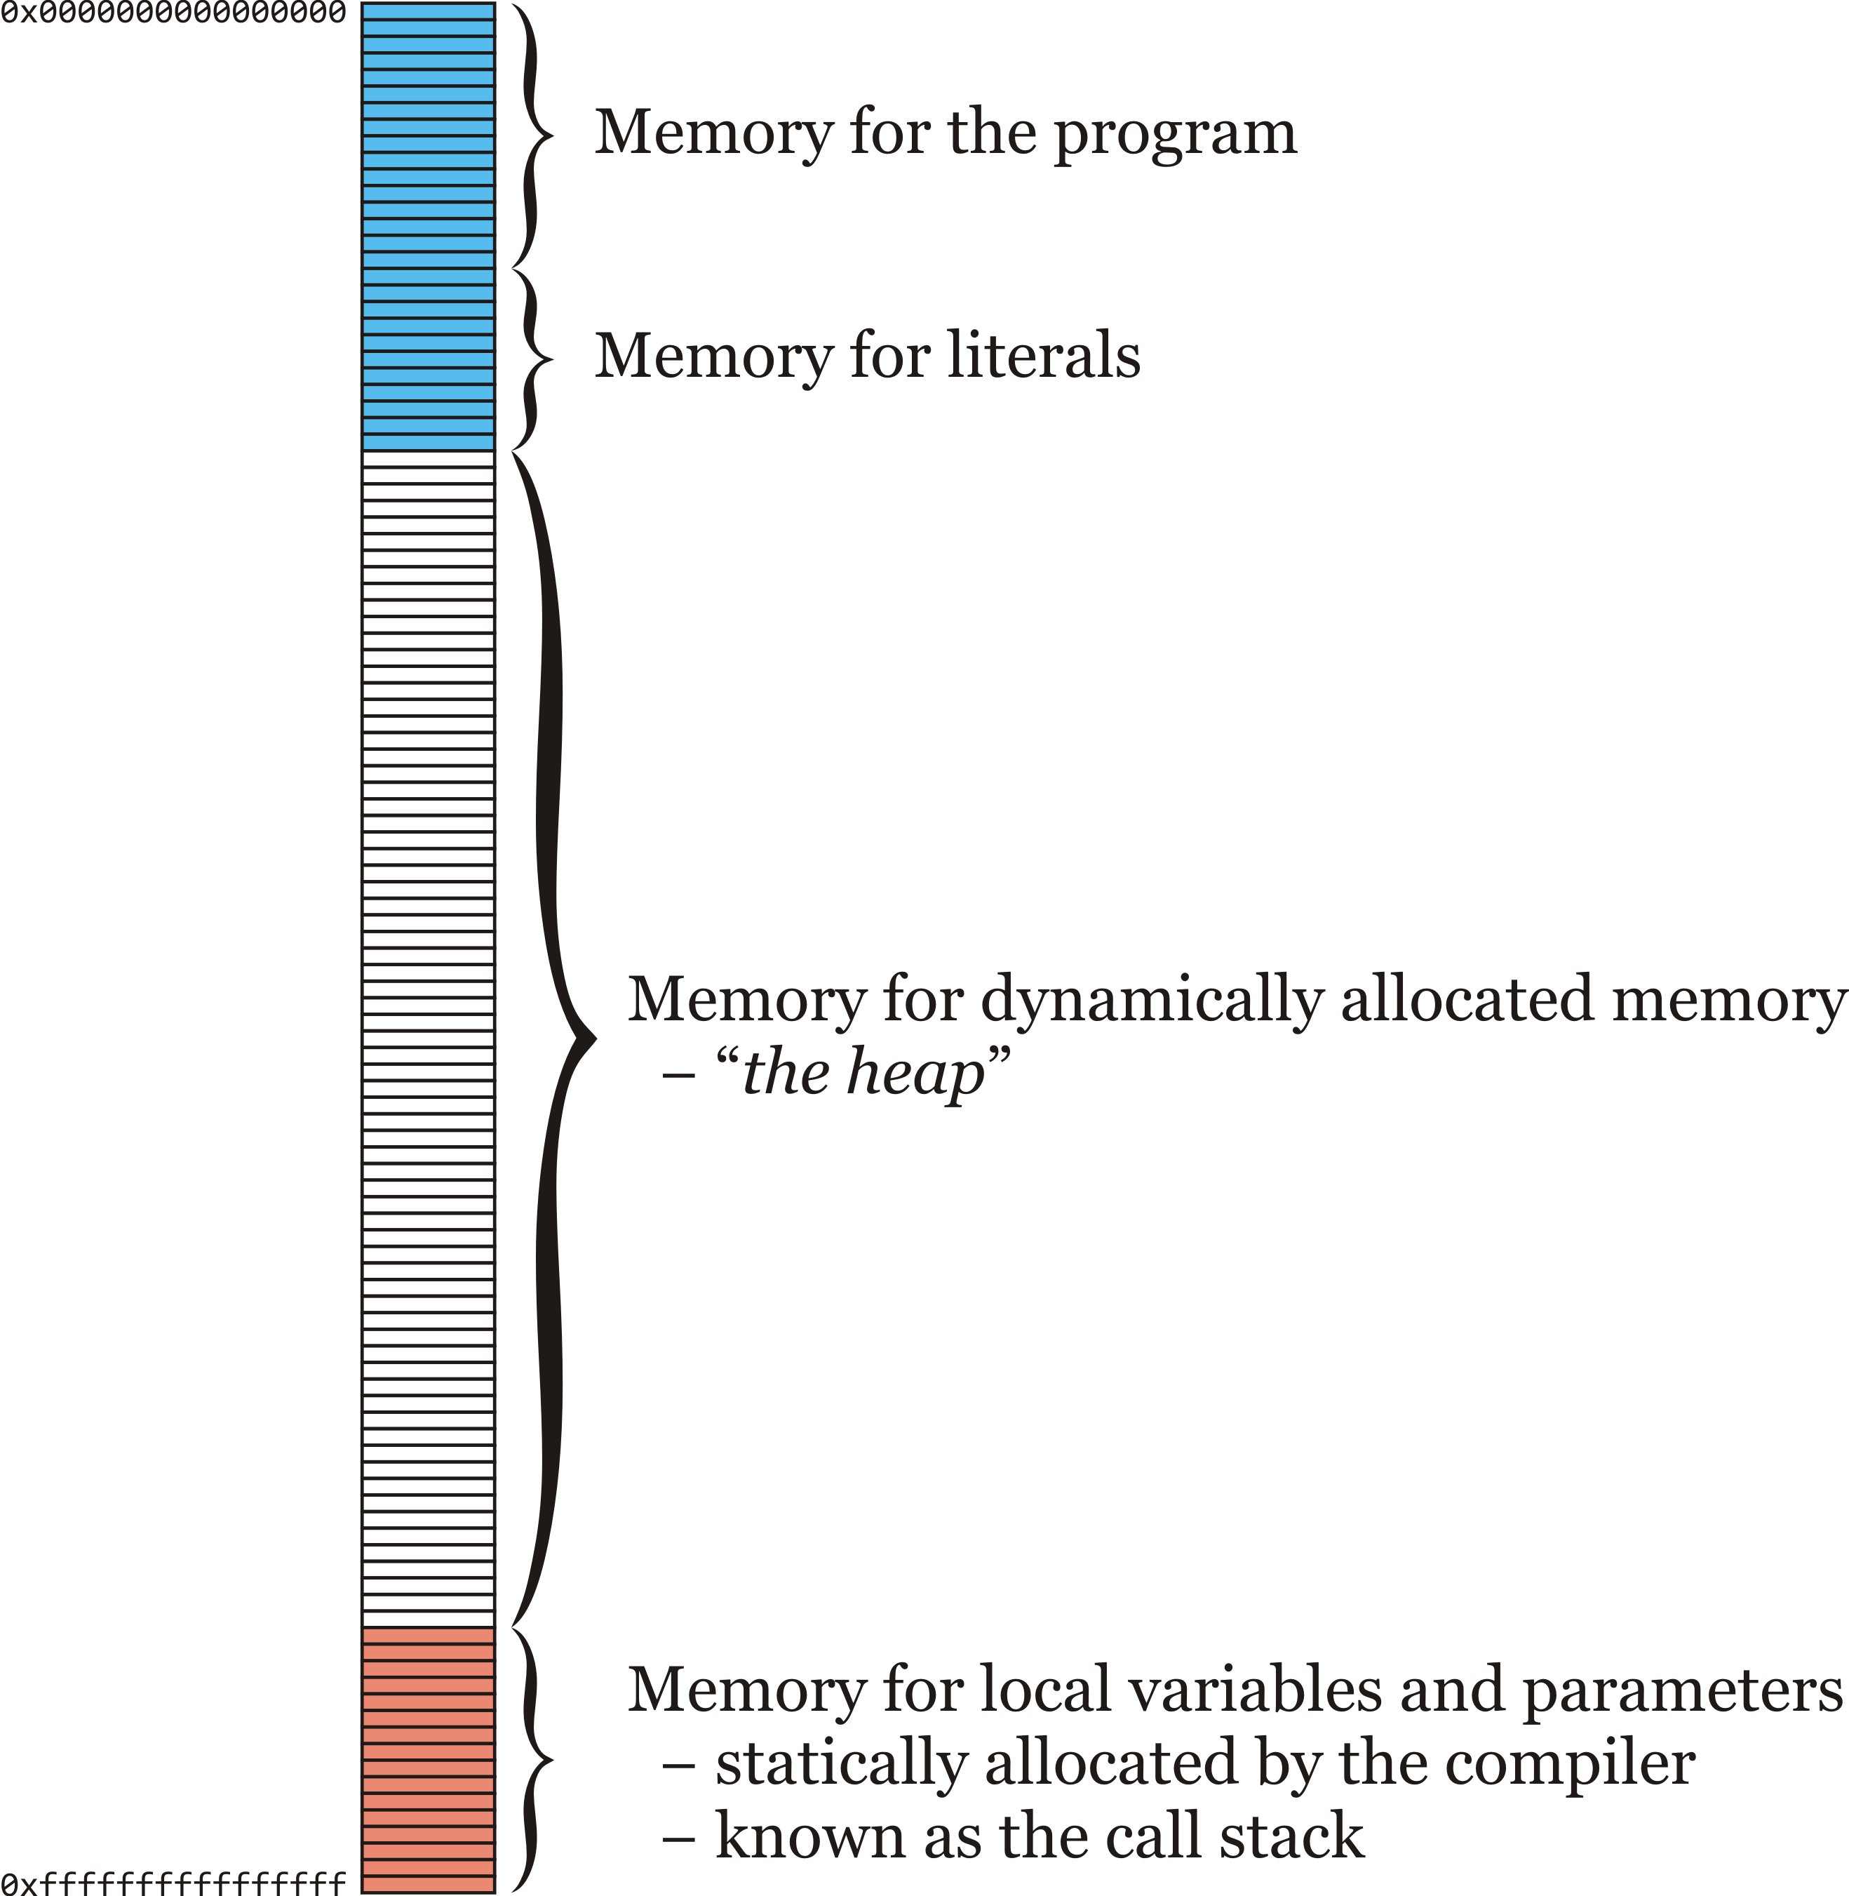
Dynamic memory
Suppose that you ask for 4 bytes:
  Some memory is allocated specifically
  for the program and literals in the
  program
  The call stack is allocated near the
  end of memory
    Statically allocated by the compiler
  All other memory may be used for
  dynamically allocated memory
    Also known as the heap

Slide 12
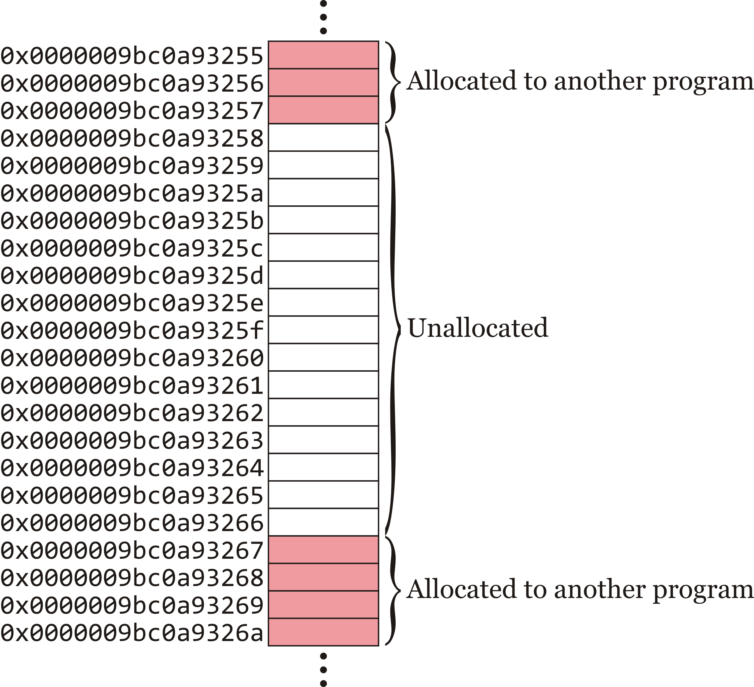
Dynamic memory
Suppose that you ask for 4 bytes:
  The operating system finds 4 bytes somewhere in the heap

Slide 13
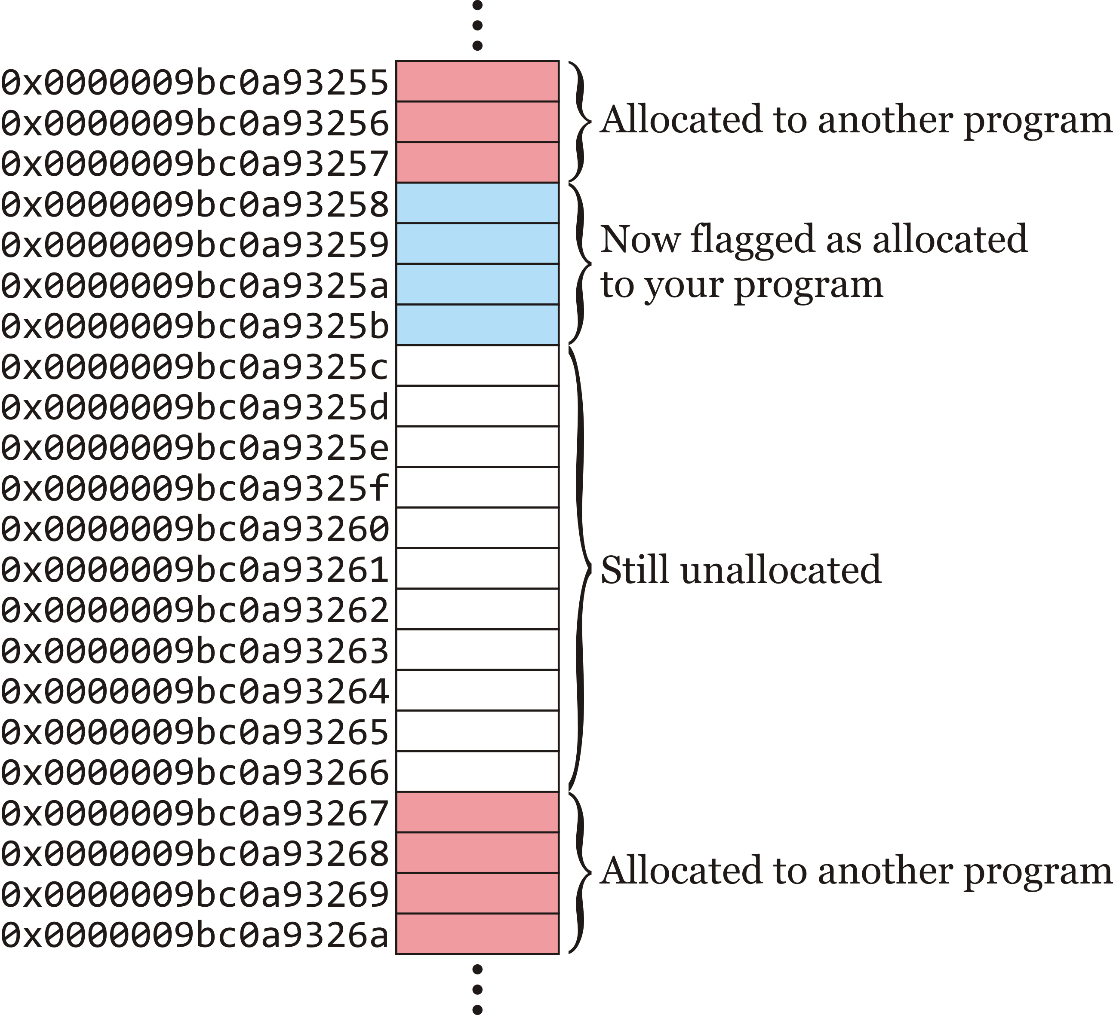
Dynamic memory
The operating system flags these as belonging to your program
  There are still 11 bytes left over, perhaps for some other request

Slide 14
Dynamic memory
How can you access this memory?
  How does the operating system tell you that these 4 bytes are yours to use?

Slide 15
Dynamic memory
A common solution is to return the address:
  “Your 4 bytes are at memory location 0x000009bc0a93258”

Slide 16
Dynamic memory
The operating system could return this address, and we can assign this address to a pointer
Question: how many bytes do you need?
  You could calculate it, but…C++ makes it easier
  The compiler does the work

Slide 17
The new operator
The keyword new defines a unary operator in C++:
  It takes a type as an operand
    Optionally, you can give the item an initial value
  It requests sufficient memory from the operating system for the type
  It returns the address supplied by the operating system
      int main() {
      // p_int is a local variable capable of
      // storing an address
      int *p_int{};
      p_int = new int{42};
      std::cout << p_int << std::endl;
      return 0;
      }

Slide 18
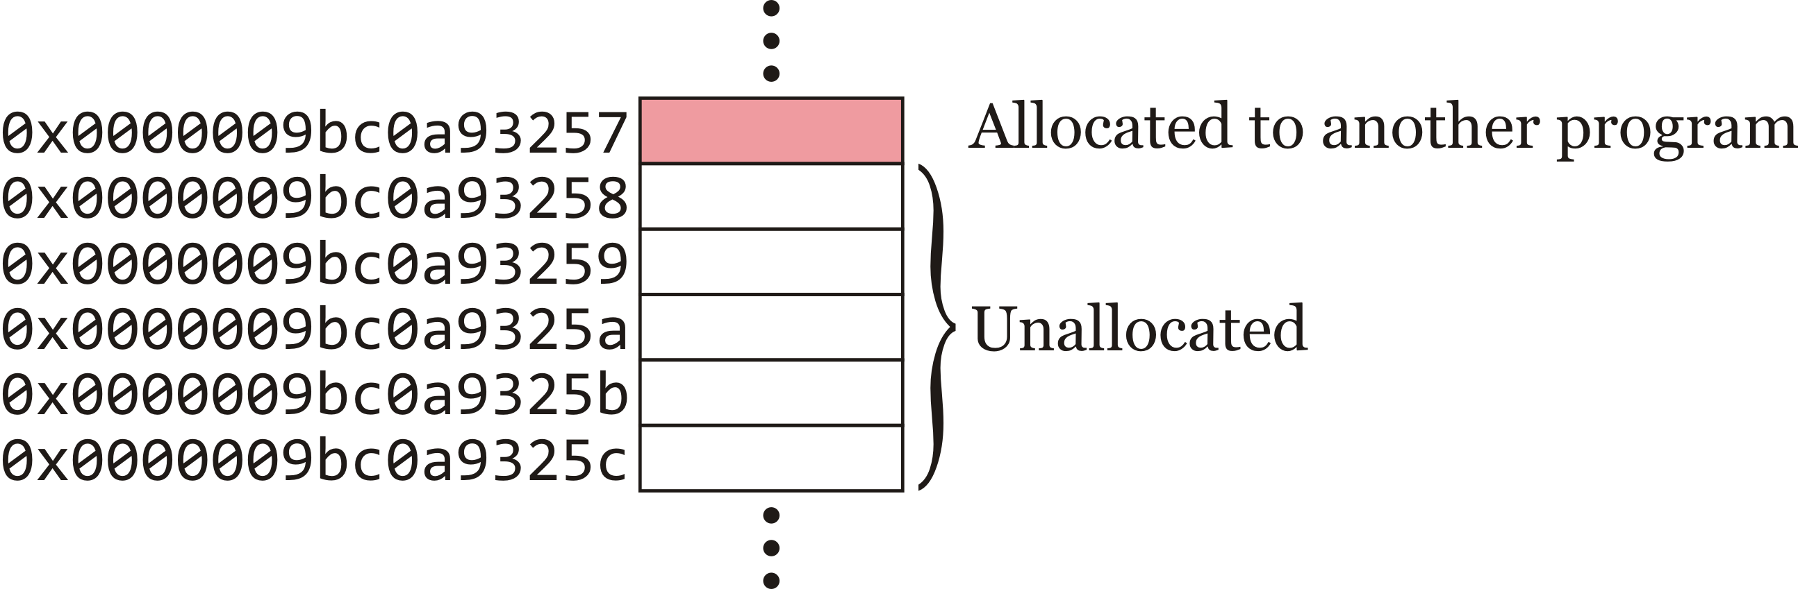
The new operator
Let’s see what happens:
  int main() {
  // p_int is a local variable capable of
  // storing an address
  int *p_int{};
  p_int = new int{42};
  std::cout << p_int << std::endl;
  return 0;
  }
p_int is a local variable
It occupies 8 bytes on the stack
It is initialized with 0x000…000

Slide 19
The new operator
Let’s see what happens:
  int main() {
  // p_int is a local variable capable of
  // storing an address
  int *p_int{};
  p_int = new int{42};
  std::cout << p_int << std::endl;
  return 0;
  }
The compiler knows an int is 4 bytes
– Behind the scene, a system call is
made requesting 4 bytes

Slide 20
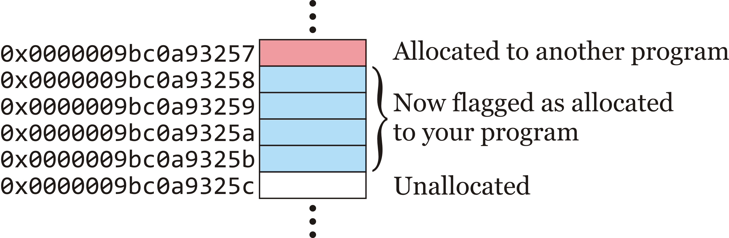
The new operator
Let’s see what happens:
  int main() {
  // p_int is a local variable capable of
  // storing an address
  int *p_int{};
  p_int = new int{42};
  std::cout << p_int << std::endl;
  return 0;
  }
The operating system finds 4 bytes and
flags it as allocated to your program
– It returns 0x9bc0a93258

Slide 21
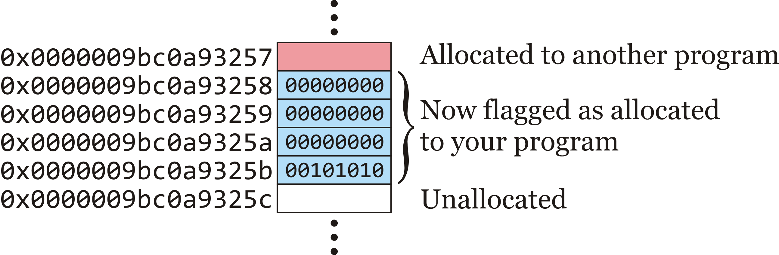
The new operator
Let’s see what happens:
  int main() {
  // p_int is a local variable capable of
  // storing an address
  int *p_int{};
  p_int = new int{42};
  std::cout << p_int << std::endl;
  return 0;
  }
The new operator now initializes
that memory with the value 42

Slide 22
The new operator
Let’s see what happens:
  int main() {
  // p_int is a local variable capable of
  // storing an address
  int *p_int{};
  p_int = new int{42};
  std::cout << p_int << std::endl;
  return 0;
  }
The value 0x9bc0a93258 is assigned
to the local variable 'p_int'

Slide 23
The new operator
Let’s see what happens:
  int main() {
  // p_int is a local variable capable of
  // storing an address
  int *p_int{};
  p_int = new int{42};
  std::cout << p_int << std::endl;
  return 0;
  }
The value 0x9bc0a93258 is printed to the console

Slide 24
The new operator
Let’s see what happens:
  int main() {
  // p_int is a local variable capable of
  // storing an address
  int *p_int{};
  p_int = new int{42};
  std::cout << p_int << std::endl;
  return 0;
  }
Your program exits

Slide 25
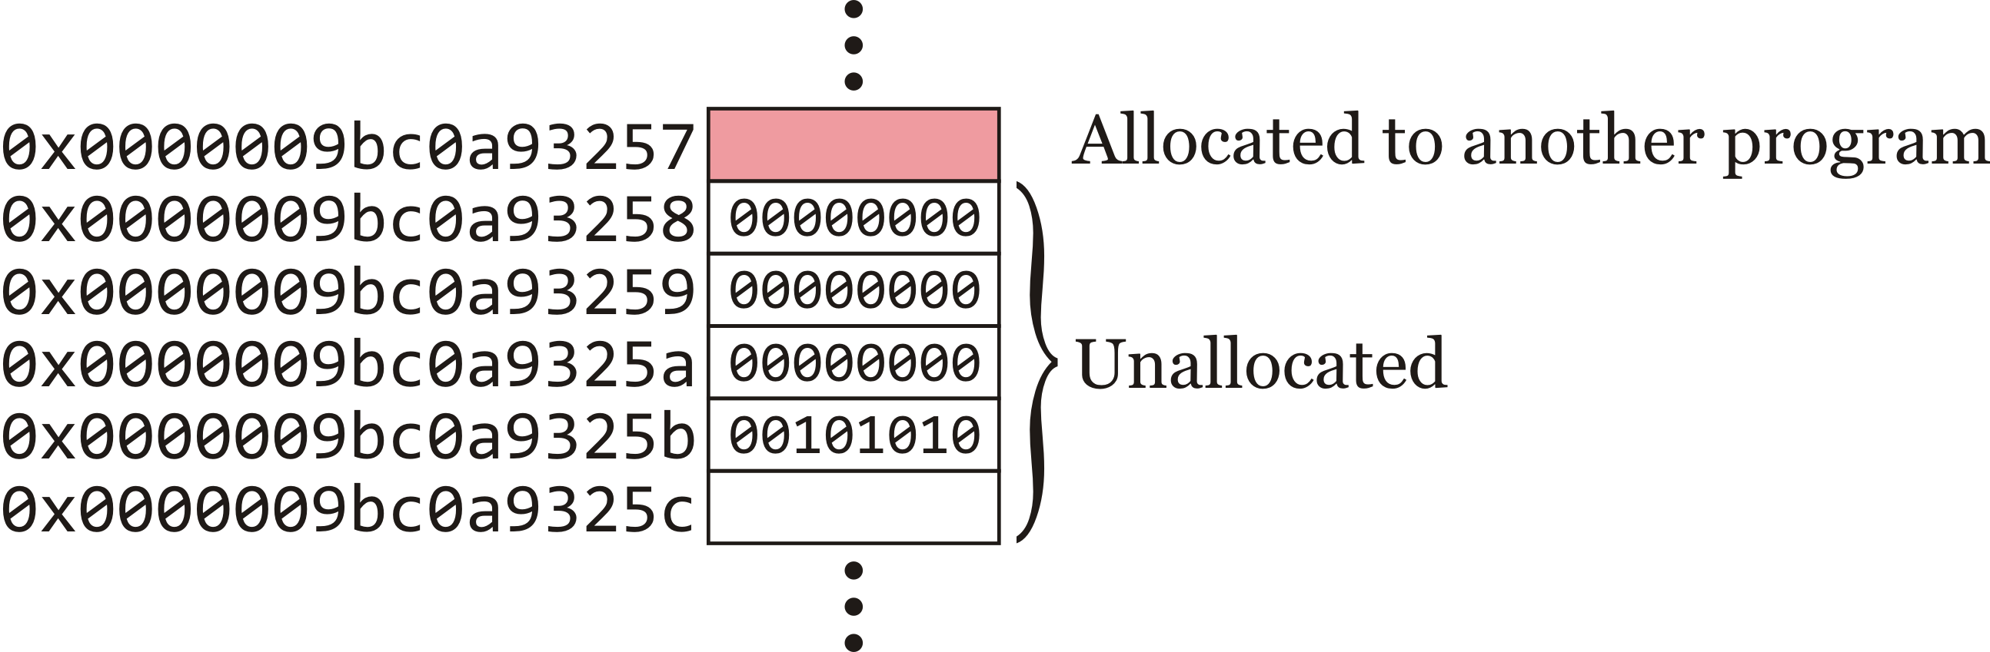
The new operator
Let’s see what happens:
  int main() {
  // p_int is a local variable capable of
  // storing an address
  int *p_int{};
  p_int = new int{42};
  std::cout << p_int << std::endl;
  return 0;
  }
The operating system realizes you have some
memory allocated, so it flags it as unallocated
– The memory still stores the value 42

Slide 26
The new operator
We can even initialize the pointer if appropriate:
    int main() {
    // p_int is a local variable capable of
    // storing an address
    int *p_int{new int{42}};
    std::cout << p_int << std::endl;
    return 0;
    }

Slide 27

The new operator
Note that the operating system cleans up your mess after your program exits
  Is this a good idea?
  Suppose you open a tab on your web browser
    That tab requires memory to be dynamically allocated
      A lot of memory if it is, for example, YouTube
  Suppose you now close that tab…
    Is it necessary that that memory remain allocated to the browser?

Slide 28
The delete operator
Just like programs can request memory, programs are able to explicitly tell the operating system when that memory is no longer needed
      int main() {
      // p_int is a local variable capable of
      // storing an address
      int *p_int{};
      p_int = new int{42};
      std::cout << p_int << std::endl;
      delete p_int;
      p_int = nullptr;
      return 0;
      }

Slide 29
The delete operator
The delete operator simply sends the address to the operating system, which then flags that memory as no longer allocated to your program
  The local variable 'p_var' is still assigned the address after delete is called—it simply passes the address on
      int main() {
      int *p_int{new int{42}};
      std::cout << p_int << std::endl;
      delete p_int;
      std::cout << p_int << std::endl;
      p_int = nullptr;
      std::cout << p_int << std::endl;
      return 0;
      }
Output:
0x12cb010
0x12cb010
0

Slide 30
Looking ahead
There are many possible issues with pointers and dynamic memory allocation
  This issues cause fear for many students
Over the next few lectures, we will address a few of this issues
  Hopefully, these will give you the confidence necessary to understand this fundamental aspect of programming

Slide 31
Summary
Following this lesson, you now
  Understand the limitations of local variables
  Know that memory can be allocated at run time
    Known as dynamic memory allocation
  Are familiar with the new and delete operators for allocation memory

Slide 32
References
[1] No references?

Slide 33



Colophon
These slides were prepared using the Georgia typeface. Mathematical equations use Times New Roman, and source code is presented using Consolas.
The photographs of lilacs in bloom appearing on the title slide and accenting the top of each other slide were taken at the Royal Botanical Gardens on May 27, 2018 by Douglas Wilhelm Harder. Please see
https://www.rbg.ca/
for more information.

Slide 34
Disclaimer
These slides are provided for the ece 150 Fundamentals of Programming course taught at the University of Waterloo. The material in it reflects the authors’ best judgment in light of the information available to them at the time of preparation. Any reliance on these course slides by any party for any other purpose are the responsibility of such parties. The authors accept no responsibility for damages, if any, suffered by any party as a result of decisions made or actions based on these course slides for any other purpose than that for which it was intended.

